Slide 1



TOC
lock
Monitor
Spinlock

Slide 2
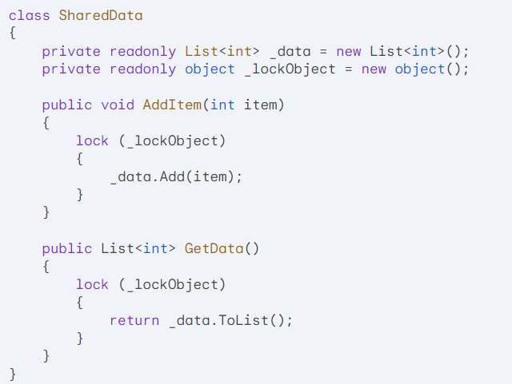

Slide 3
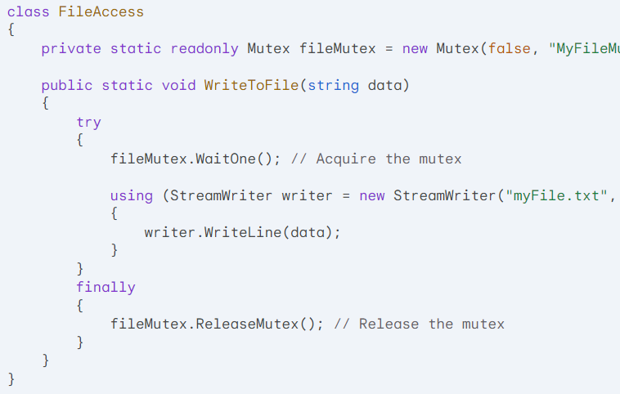

Slide 4
Operating System Locks vs. General Locks
In C#, there are two primary types of locks used for synchronization: operating system locks and general locks.

Slide 5
Operating System Locks:
Mechanism: Implemented at the operating system level, typically using system calls.
Examples: Mutex, Semaphore, EventWaitHandle
Use Cases:
Protecting shared resources across processes.
Coordinating threads or processes that belong to different applications.
Ensuring system-wide synchronization.

Slide 6
General Locks:
Mechanism: Implemented within the .NET framework, using managed code.
Examples: lock keyword, Monitor class
Use Cases:
Protecting shared resources within a single process.
Coordinating threads within the same application.

Slide 7
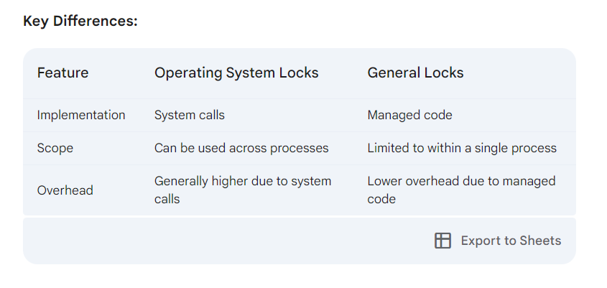

Slide 8
Choosing the Right Lock:
Operating System Locks: Use when you need to synchronize across processes or when you require system-level guarantees.
General Locks: Use for most synchronization scenarios within a single process, as they offer lower overhead and are easier to use.

Slide 9
Real-World Examples:
Operating System Locks:
Protecting shared files or network resources.
Coordinating threads or processes belonging to different applications.
Implementing system-wide synchronization mechanisms.
General Locks:
Protecting shared data structures within a single application.
Coordinating threads within a producer-consumer pattern.
Implementing synchronization mechanisms for asynchronous operations.

Slide 10
Operating System Locks
Mutex:
Ensures exclusive access to a shared resource across processes.
Used for system-level synchronization and protecting shared resources.
Semaphore:
Limits the number of concurrent threads or processes that can access a shared resource.
Used for resource pooling, rate limiting, and controlling concurrency.
EventWaitHandle:
Signals and waits for events between threads or processes.
Used for coordinating asynchronous operations, producer-consumer patterns, and barriers.

Slide 11
General Locks
lock Keyword:
A shorthand for acquiring and releasing a lock on an object.
Used for protecting shared data within a single process.
Monitor Class:
Provides more granular control over synchronization, including waiting and signaling.
Used for coordinating threads, implementing producer-consumer patterns, and protecting shared data.
SpinLock:
A lightweight lock that spins in a loop, avoiding operating system calls.
Suitable for short-lived critical sections with low contention.

Slide 12
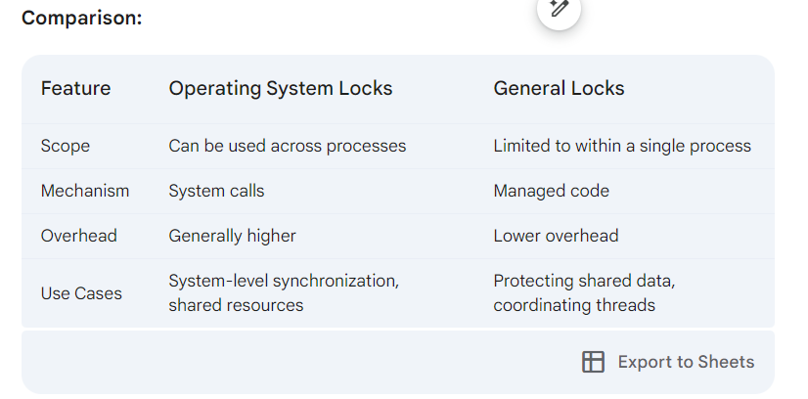

Slide 13
Monitor

Slide 14
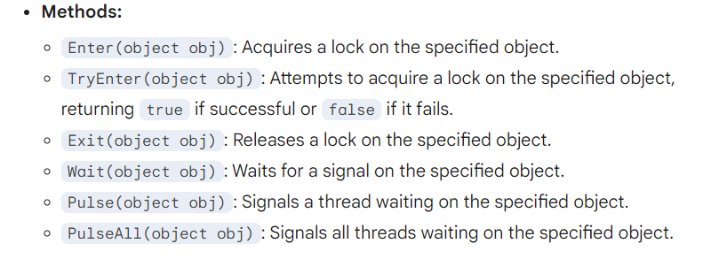
Purpose: A Monitor is a synchronization primitive used to acquire and release locks on shared resources. It provides more granular control over locking than the lock keyword.

Slide 15
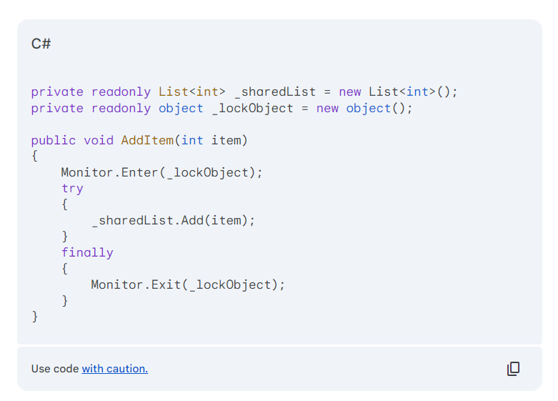
Protecting Shared Data Structures:

Slide 16
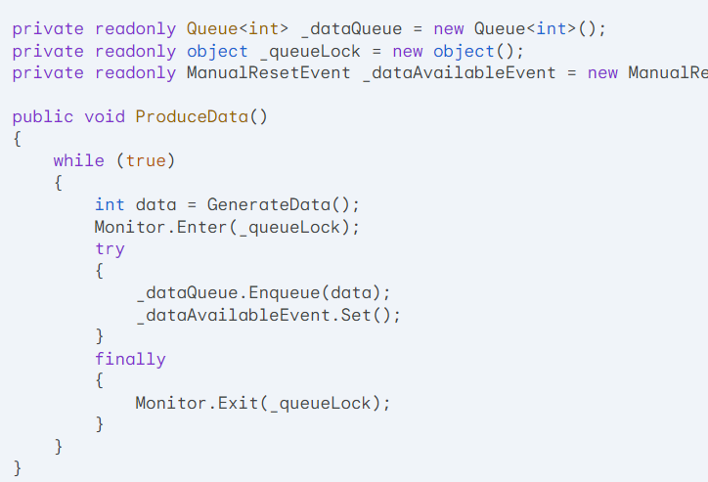
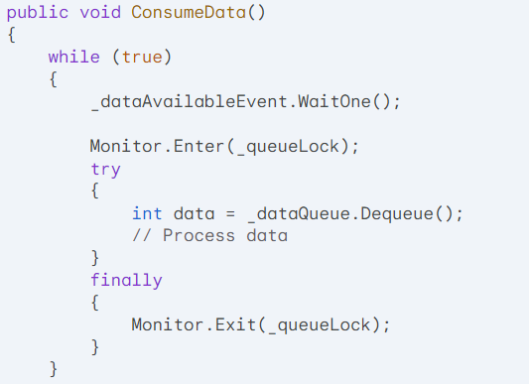
Implementing Producer-Consumer Patterns:

Slide 17
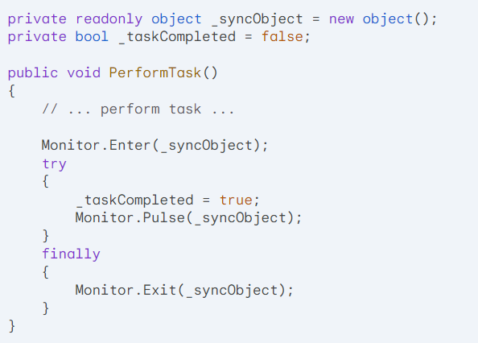
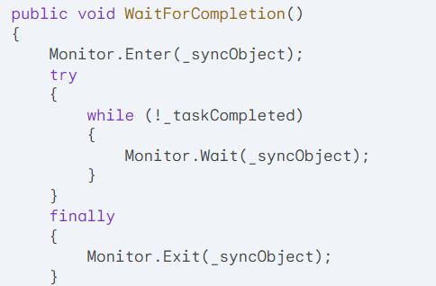
Coordinating Multiple Threads:

Slide 18
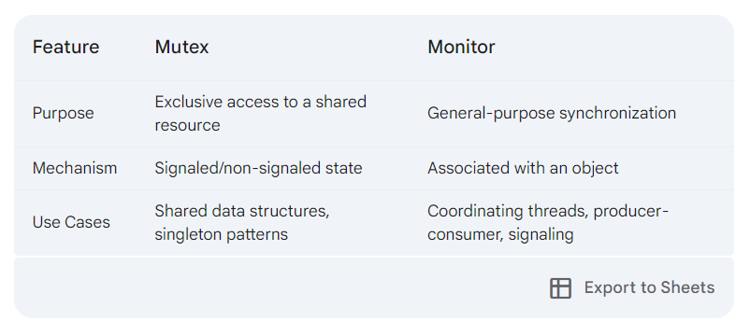

Slide 19
Signaled/Non-Signaled State vs. Associated with an Object
These terms refer to the underlying mechanisms of two different synchronization primitives in C#: Mutex and Monitor.

Slide 20
Signaled/Non-Signaled State:
Used in: AutoResetEvent/Mutex
Meaning: An AutoResetEvent can be in either a signaled or non-signaled state.
Signaled: Indicates that the event has occurred, and a waiting thread can proceed.
Non-signaled: Indicates that the event has not occurred yet, and waiting threads must continue to wait.
Purpose: Used for signaling and waiting for events between threads.

Slide 21
Associated with an Object:
Used in: Monitor
Meaning: A Monitor is associated with a specific object. When a thread acquires a lock on the object, other threads that attempt to acquire the same lock must wait until it's released.
Purpose: Provides a more flexible approach to synchronization, allowing for locking, waiting, and signaling.

Slide 22
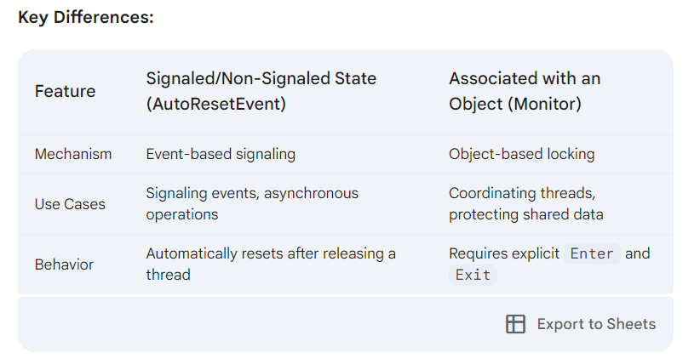

Slide 23
Categorizing Locks in C#
Operating System Locks
Mutex:
Ensures exclusive access to a shared resource across processes.
Used for system-level synchronization and protecting shared resources.
Semaphore:
Limits the number of concurrent threads or processes that can access a shared resource.
Used for resource pooling, rate limiting, and controlling concurrency.
EventWaitHandle:
Signals and waits for events between threads or processes.
Used for coordinating asynchronous operations, producer-consumer patterns, and barriers.

Slide 24
General Locks
lock Keyword:
A shorthand for acquiring and releasing a lock on an object.
Used for protecting shared data within a single process.
Monitor Class:
Provides more granular control over synchronization, including waiting and signaling.
Used for coordinating threads, implementing producer-consumer patterns, and protecting shared data.
SpinLock:
A lightweight lock that spins in a loop, avoiding operating system calls.
Suitable for short-lived critical sections with low contention.

Slide 25
Spinlock

Slide 26
Purpose: A SpinLock is a synchronization primitive used to acquire and release locks on shared resources. Unlike Mutex and Monitor, SpinLock does not involve operating system calls, making it potentially more efficient for short-lived critical sections.
Mechanism: A SpinLock is acquired by spinning in a loop, repeatedly checking for availability. Once acquired, the lock is held until it's explicitly released.
Use Cases:
Protecting short-lived critical sections.
Avoiding the overhead of operating system calls.
Optimizing performance in scenarios where contention is low.

Slide 27
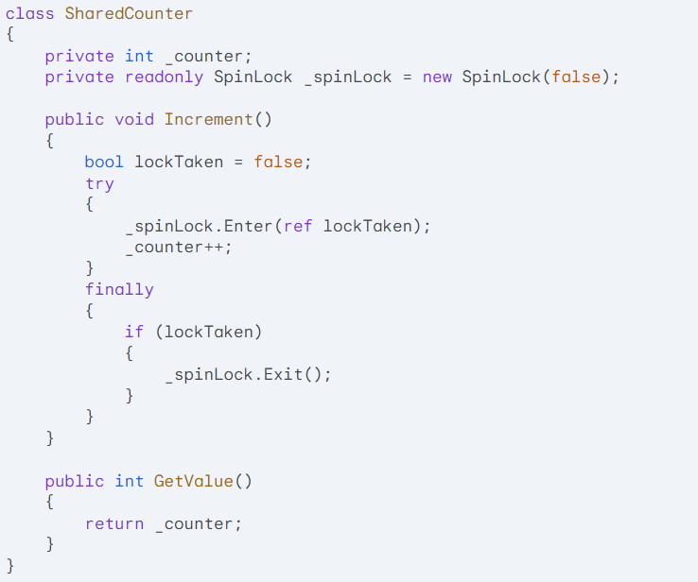

Slide 28
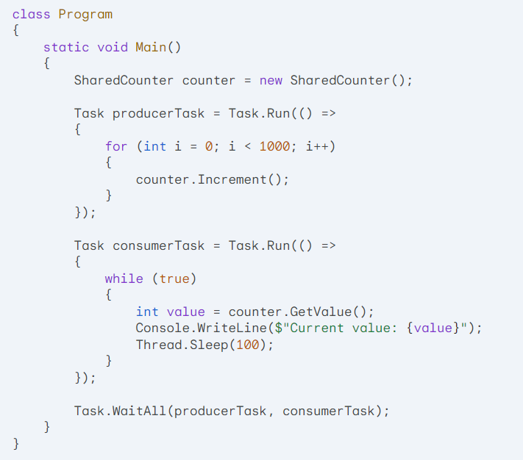

Slide 29
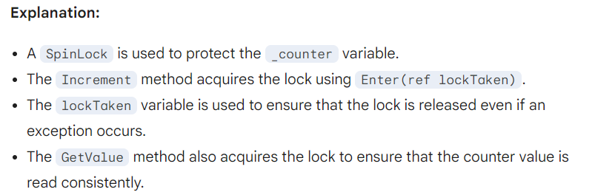

Slide 31
Key Points:
SpinLock is suitable for short-lived critical sections where contention is low.
For long-running critical sections, consider using Mutex or Monitor to avoid excessive CPU usage.
Use Enter(ref lockTaken) and Exit() to acquire and release the lock.
Be aware of potential performance implications of excessive spinning.

Slide 32
Additional Considerations:
You can use SpinLock.IsHeld to check if the lock is currently held by the current thread.
For more complex scenarios, consider using SpinLock in combination with other synchronization primitives.
By effectively using SpinLock, you can optimize performance in certain scenarios where contention is low and avoid the overhead of operating system calls.

Slide 33
How SpinLock works:
Acquiring the Lock: When a thread tries to acquire a SpinLock, it enters a loop and repeatedly checks if the lock is available. If the lock is not available, the thread continues to spin in the loop, consuming CPU cycles.
Releasing the Lock: Once the thread acquires the lock, it can access the shared resource. When it's done, it releases the lock, allowing other threads to acquire it.

Slide 34
Key Considerations:
Contention: If contention is high, excessive spinning can lead to increased CPU usage.
Long-Running Critical Sections: For long-running critical sections, Mutex or Monitor might be more suitable to avoid excessive CPU usage.
Deadlock Potential: Be cautious when using SpinLock in conjunction with other synchronization primitives to avoid deadlocks.

Slide 35
Real-Time Scenarios for SpinLock

Slide 36
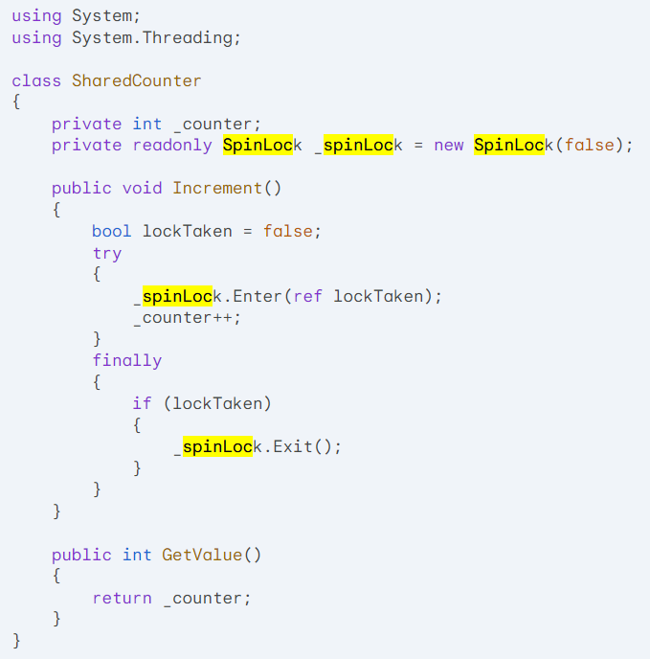

Slide 37
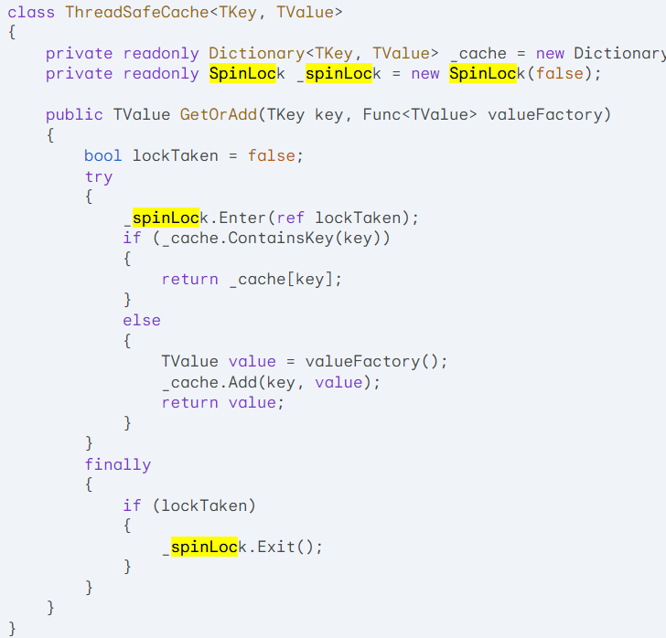
2. Cache Management
Scenario: Implementing a thread-safe cache with frequent updates and lookups.
Example:

Slide 38
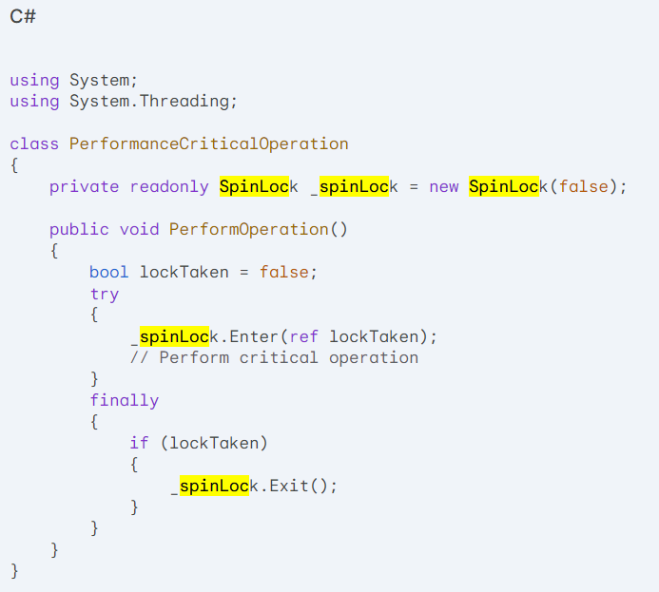
3. Performance-Critical Code Sections
Scenario: Optimizing performance-critical code sections that involve shared resources.
Example:

Slide 39
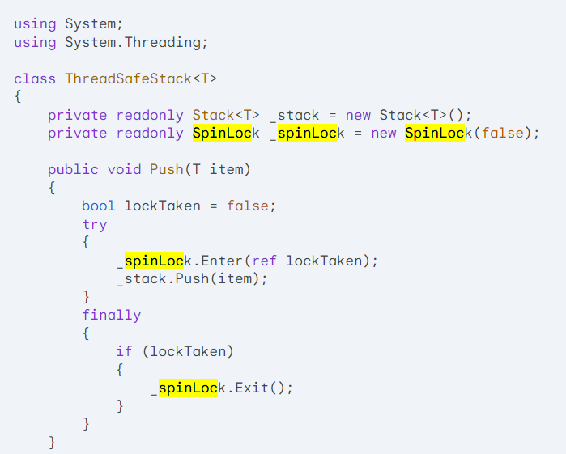
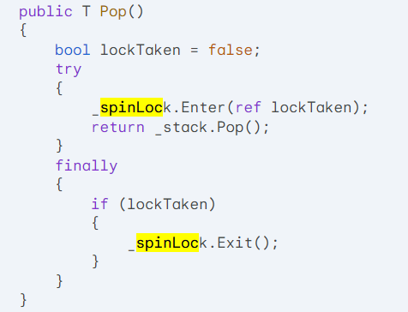
4. Custom Data Structures
Scenario: Implementing thread-safe custom data structures like stacks, queues, or linked lists.
Example:

